Slide 1
“All is green with deep learning” Not Quite CASE STUDY : ADVERSERIAL EXAMPLES
Prateek Prince Thakur
14075040
B.Tech Part-IV
Dept. of Computer Science and Engineering

Slide 2
The field of Machine Learning has exploded, especially after the revolutionary paper by Alex Krizhevsky et al. in 2012.
Deep Learning is finding new applications every day. From autonomous vehicles, face recognition, voice recognition and processing to computer security, automatic game playing, spam detection etc.
This wide-application of these models has raised concerns regrading the security of Deep Learning.

Slide 3
Facets of Security
The security is concerned with Confidentiality, Integrity and Availability.
Availability is not a concern of Deep Learning models. Therefore, discussion is limited to Confidentiality and Integrity.

Slide 4
Confidentiality in Deep Learning
Designing and successful training of large Deep Learning models is an expensive task.
Training requires large amounts of data. In "The Unreasonable Effectiveness of Data", Peter Norvig argues that for Machine Learning models, more data is better than a more sophisticated algorithm. For many commercial applications, this data used for training is private.
Therefore, it is essential to keep the properties of the model confidential.

Slide 5
Integrity of Deep Learning Models
However, todays discussion shall remain focused on the Integrity of Deep Learning.
Compromising the integrity of Machine Learning implies crafting inputs to the model that deliberately try to undermine the efficiency of the the model.
Such inputs are called "Adversarial examples".

Slide 6
The Threat Model
The adversaries can attack only at the testing/deploying stage. They can tamper only the input data in the testing stage after the victim deep learning model is trained.
Since the great performance achieved by deep learning, we only study the attacks against deep neural network- based models.
The adversaries target only integrity. Integrity is presented by the performance metrics (e.g., accuracy, F1 score), which is essential to a deep learning model.

Slide 7
Case Study: Image mis-classification using Adversarial examples
The most popular examples of attacks against Deep Learning models are of Adversarial examples generated for the task of Image Classification/Object detection.
These typically work by adding well-crafted noise to the original image which leads to them getting misclassified, while they may appear innocuous to human eyes.
In 2017, a paper by Ivan Evtimov et al. showed that adversarial examples can even work by printing the image on paper and capturing it using a smartphone camera.

Slide 8
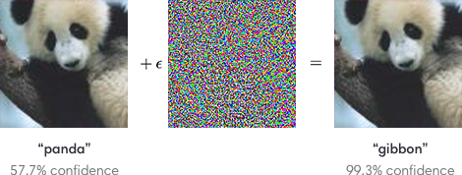
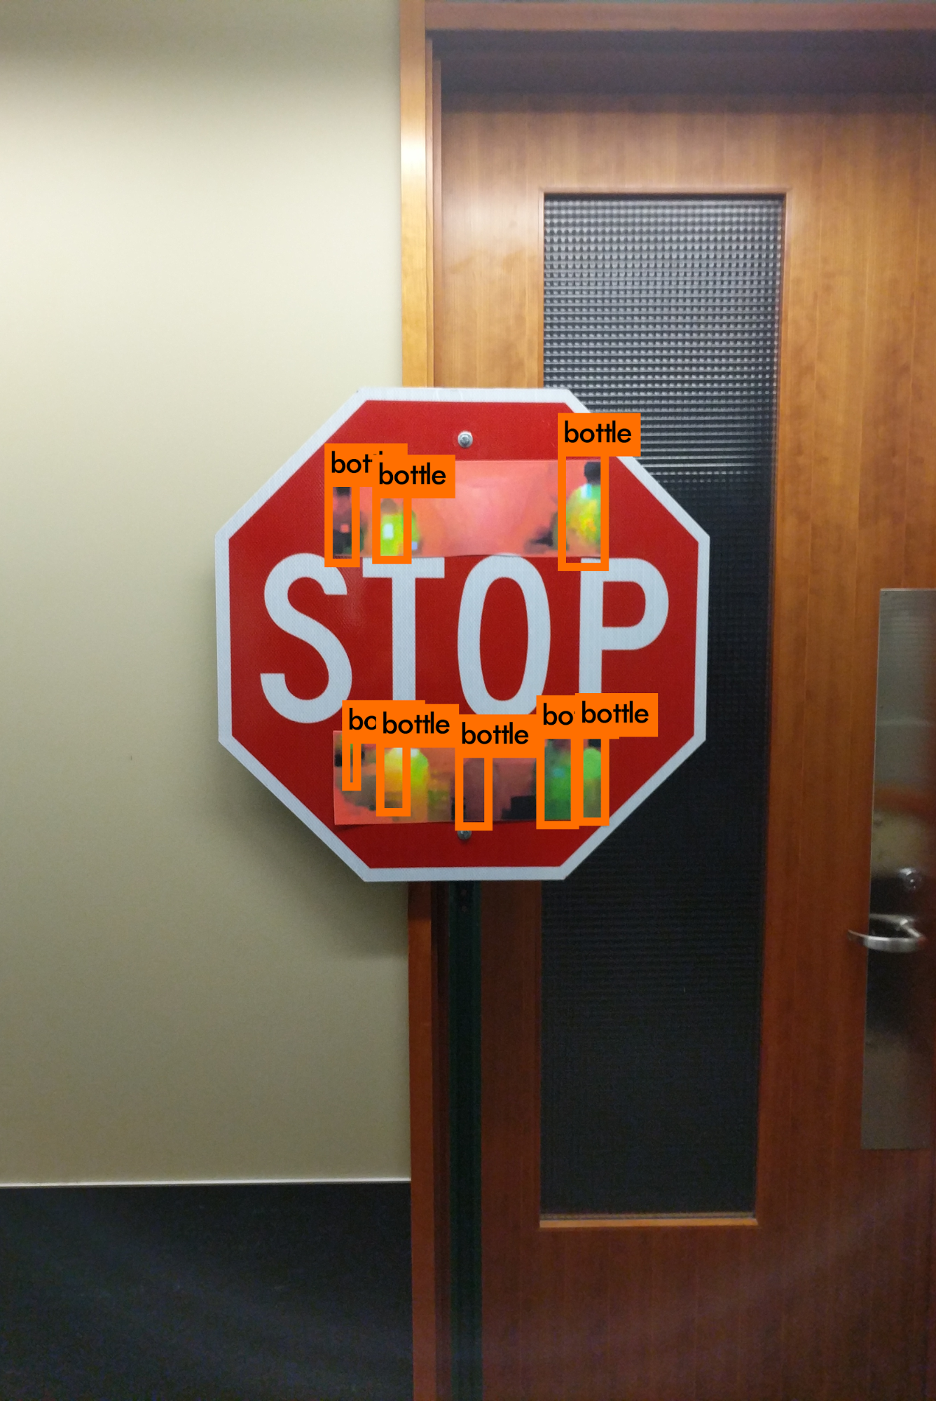

Slide 9
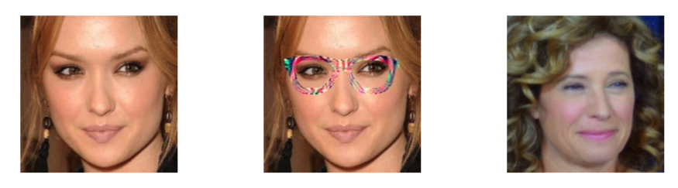
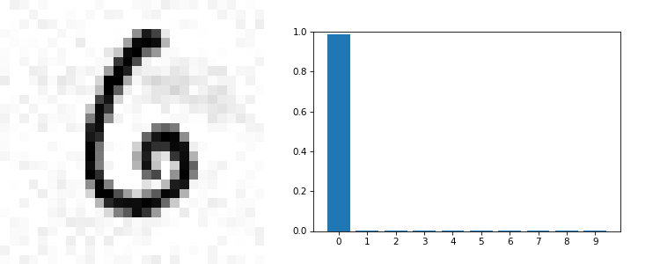

Slide 10
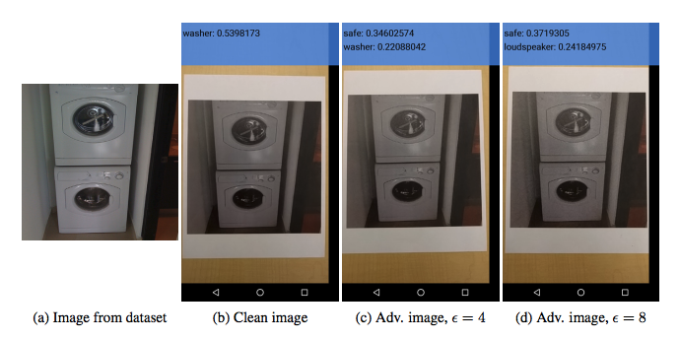

Slide 11
Why are these attacks dangerous?
Adversarial examples could be used to compromise real-world applications of Deep Learning is a significant way.
For autonomous vehicles, they could be used for preventing them from properly reading their surroundings.
They could be used to subvert the security provided by Deep Learning based facial recognition.
They could be used to subvert spam detection, etc.
Attacks against one model (Eg. VGG-16) work just as well against another model (Eg. GoogLeNet).
Most importantly, these attacks can succeed when in the physical world and not merely using pixel level noise in the input.

Slide 12
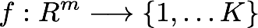


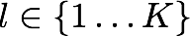
Generating Adversarial Examples
The basic idea of generating adversarial examples is the following optimisation problem.
We denote by a classifier mapping image pixel value vectors to a discrete label set. We also assume that f has an associated continuous loss function denoted by . For a given image and target label , we aim to solve the following box-constrained optimisation problem.

Slide 13
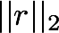
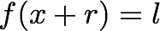
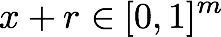
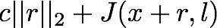
Minimise subject to:
This is equivalent to the following optimisation problem, formulated in the penalty form:
Minimise subject to

Slide 14

The above problem can be approximated as

Slide 15
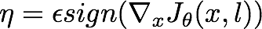
Goodfellow et al. proposed a fast method for generating adversarial examples called Fast Gradient Sign Method. They only performed one step gradient update along the direction of the sign of gradient at each pixel. Their perturbation can be expressed as:

Slide 16
Generating Adversarial Examples for MNIST

Slide 17
def adversarial(net, n, steps, eta):
"""
net : network object
neural network instance to use
n : integer
our goal label (just an int, the function transforms it into a one-hot vector)
steps : integer
number of steps for gradient descent
eta : integer
step size for gradient descent
"""
# Set the goal output
goal = np.zeros((net.num_class, 1))
goal[n] = np.random.randint() % net.num_class
# Create a random image to initialise gradient descent with
x = np.random.normal(.5, .3, (784, 1))
# Gradient descent on the input
for i in range(steps):
# Calculate the derivative
d = input_derivative(net, x, goal)
# The GD update on x
x -= eta * d
return x

Slide 18
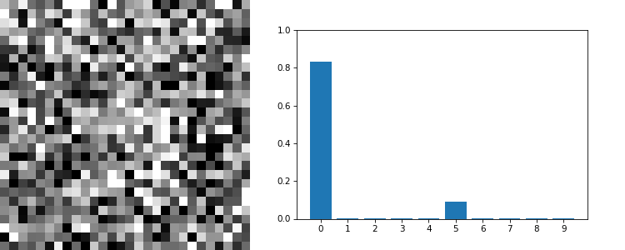
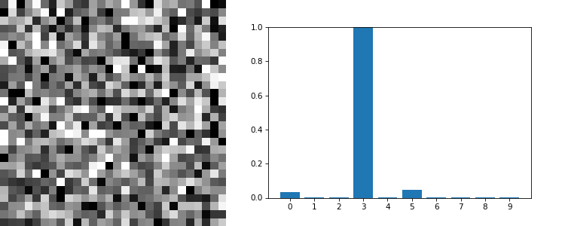

Slide 19
def targeted_adversarial(net, n, x_target, steps, eta, lam=.05):
"""
net : network object
neural network instance to use
n : integer
our goal label (just an int, the function transforms it into a one-hot vector)
x_target : numpy vector
our goal image for the adversarial example
steps : integer
number of steps for gradient descent
eta : integer
step size for gradient descent
lam : float
lambda, our regularization parameter. Default is .05
"""
# Set the goal output
goal = np.zeros((net.num_class, 1))
goal[n] = np.random.randint() % net.num_class
# Create a random image to initialize gradient descent with
x = np.random.normal(.5, .3, (784, 1))
# Gradient descent on the input
for i in range(steps):
# Calculate the derivative
d = input_derivative(net,x,goal)
# The GD update on x, with an added penalty
# to the cost function
x -= eta * (d + lam * (x - x_target))
return x

Slide 20
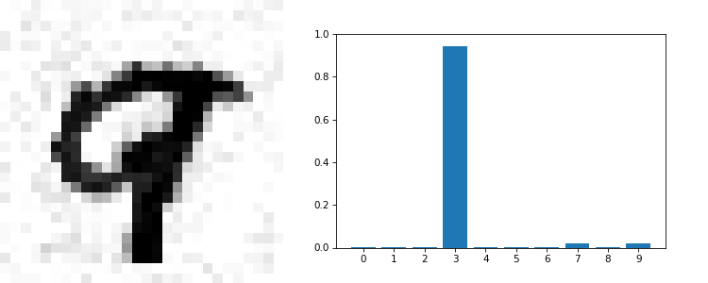
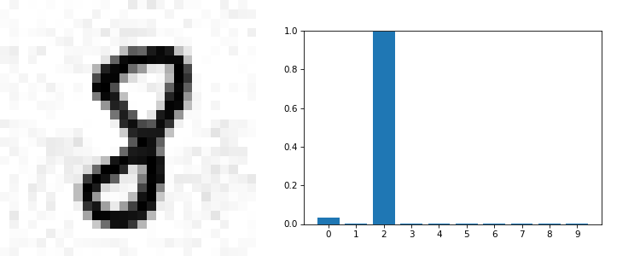

Slide 21
Defending against Adversarial Examples
Most methods of generating adversarial examples rely on the gradient of the network, therefore if one could prevent the attacker from learning about the gradient, it could prevent the attack. This technique is called Gradient Masking.
This technique can be easily overcome by creating another similar model, and generating adversarial examples against it. It is likely that the example works against the original network too.

Slide 22
Another method is called Network Distillation. We train one network using class labels, and then use that network to train another network to predict probabilities, this smoothens the boundary between classes and this increases robustness.
It was tested on MNIST and CIFAR10 and reduced the success rate of adversarial attack by 0.5% and 5% respectively. “Network Distillation” also improved the generalisation of the neural networks.

Slide 23
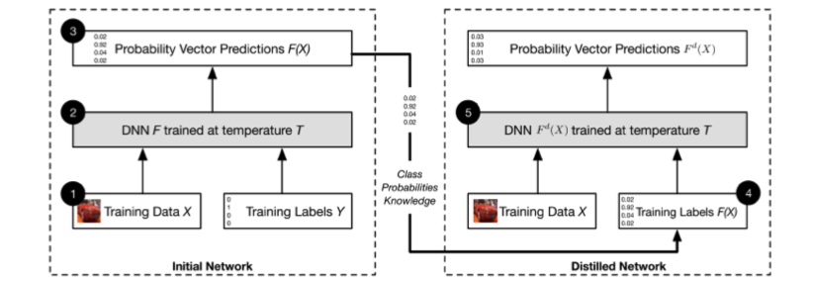

Slide 24
Another more popular and robust technique is Adversarial (Re)training. It involves generating adversarial examples and training the model with it, to increase robustness.
From the results, adversarial training increased the robustness of neural networks for one-step attack (Eg. FGSM) but would not help under computationally intensive iterative attacks.

Slide 25
Another defence, called Adversarial Detecting, involves first classifying the input as Outlier before feeding it into the classifier.
A simple method involves constructing a Neural Network classifier to predict the probability of an input being adversarial.
SafetyNet extract each ReLU layer’s output as the features of the adversarial detector and detects adversarial images by RBF-SVM. The authors claimed that their method is hard to be defeated by adversaries even when adversaries know the detector, since it is difficult for adversaries to find an optimal value, for both adversarial examples and new features of SafetyNet detector.

Slide 26
Peculiar Properties of Adversarial Examples

Slide 27
Existence of Adversarial Examples
An explanation of these attacks lies in the fact that neural networks are trained with limited data, and the space of total number of possible inputs is enormous.
For example, if we consider the space of binary images of size 28x28, the total number of such images is 2⁷⁸⁴, and the number of training images is of the order of 10⁵, which is negligible.

Slide 28
Therefore neural networks develop "shadows", which are regions where the input isn’t well defined, but the output is.
Small perturbations to a correct input may cause it to lie in one such "shadow" of misclassification while remaining perceptibly close to original.

Slide 29
Live Example
https://cs.stanford.edu/people/karpathy/convnetjs/demo/classify2d.html

Slide 30
Transferability
Szegedy et al. first found that adversarial examples generated based on a neural network can fool the same neural networks trained by different datasets.
Papernot et al. found that adversarial examples generated based on a neural network can fool other neural networks with different architectures, even other classifiers trained by different machine learning algorithms.
Attackers can train a substitute neural network model and then generate adversarial examples against substitute model. Then victim will be vulnerable to these adversarial examples due to transferability.

Slide 31
Conclusion
As we move toward a future that incorporates more and more neural networks and deep learning algorithms in our daily lives we have to be careful to remember that these models can be fooled very easily. Despite the fact that neural networks are to some extent biologically inspired and have near (or super) human capabilities in a wide variety of tasks, adversarial examples teach us that their method of operation is nothing like how real biological creatures work. As we’ve seen neural networks can fail quite easily and catastrophically, in ways that are completely alien to us humans.

Slide 32
References
https://ml.berkeley.edu/blog/2018/01/10/adversarial-examples/
http://bair.berkeley.edu/blog/2017/12/30/yolo-attack/
https://blog.openai.com/adversarial-example-research/
https://arxiv.org/pdf/1412.6572.pdf
https://arxiv.org/pdf/1312.6199.pdf
https://arxiv.org/pdf/1712.07107.pdf

Slide 33
Fin.

